Slide 1
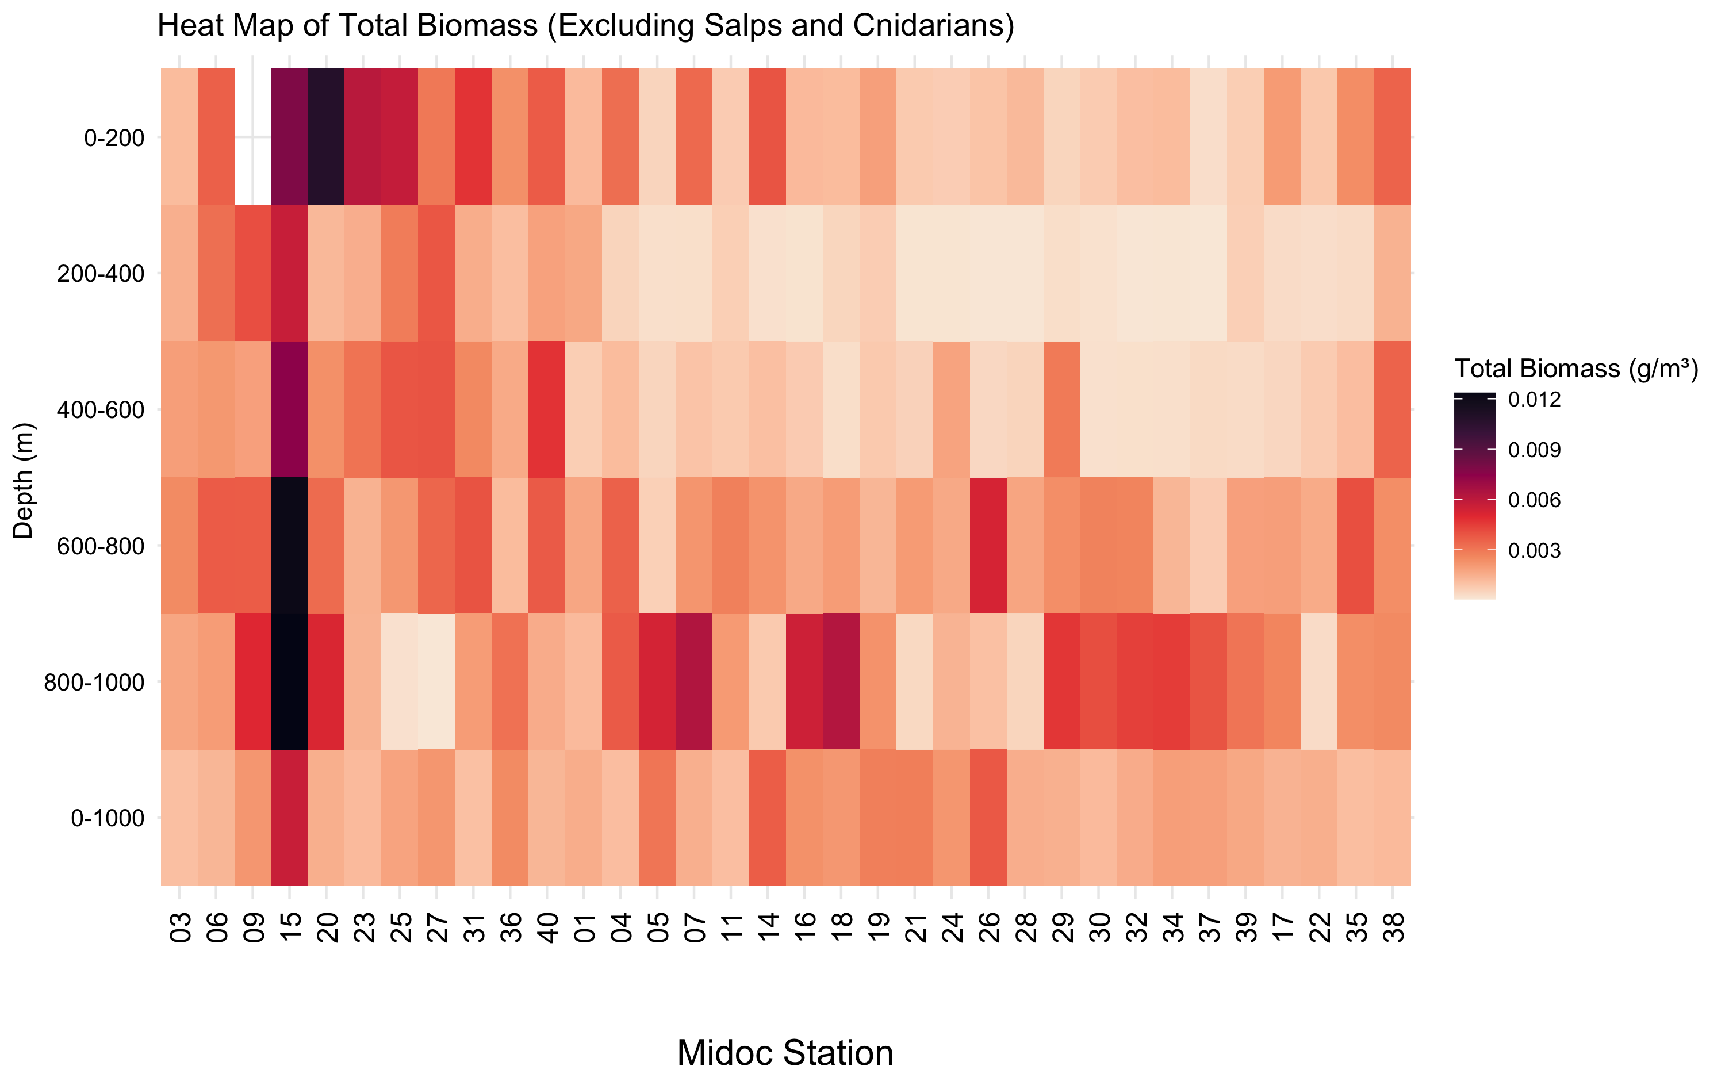




Slide 2
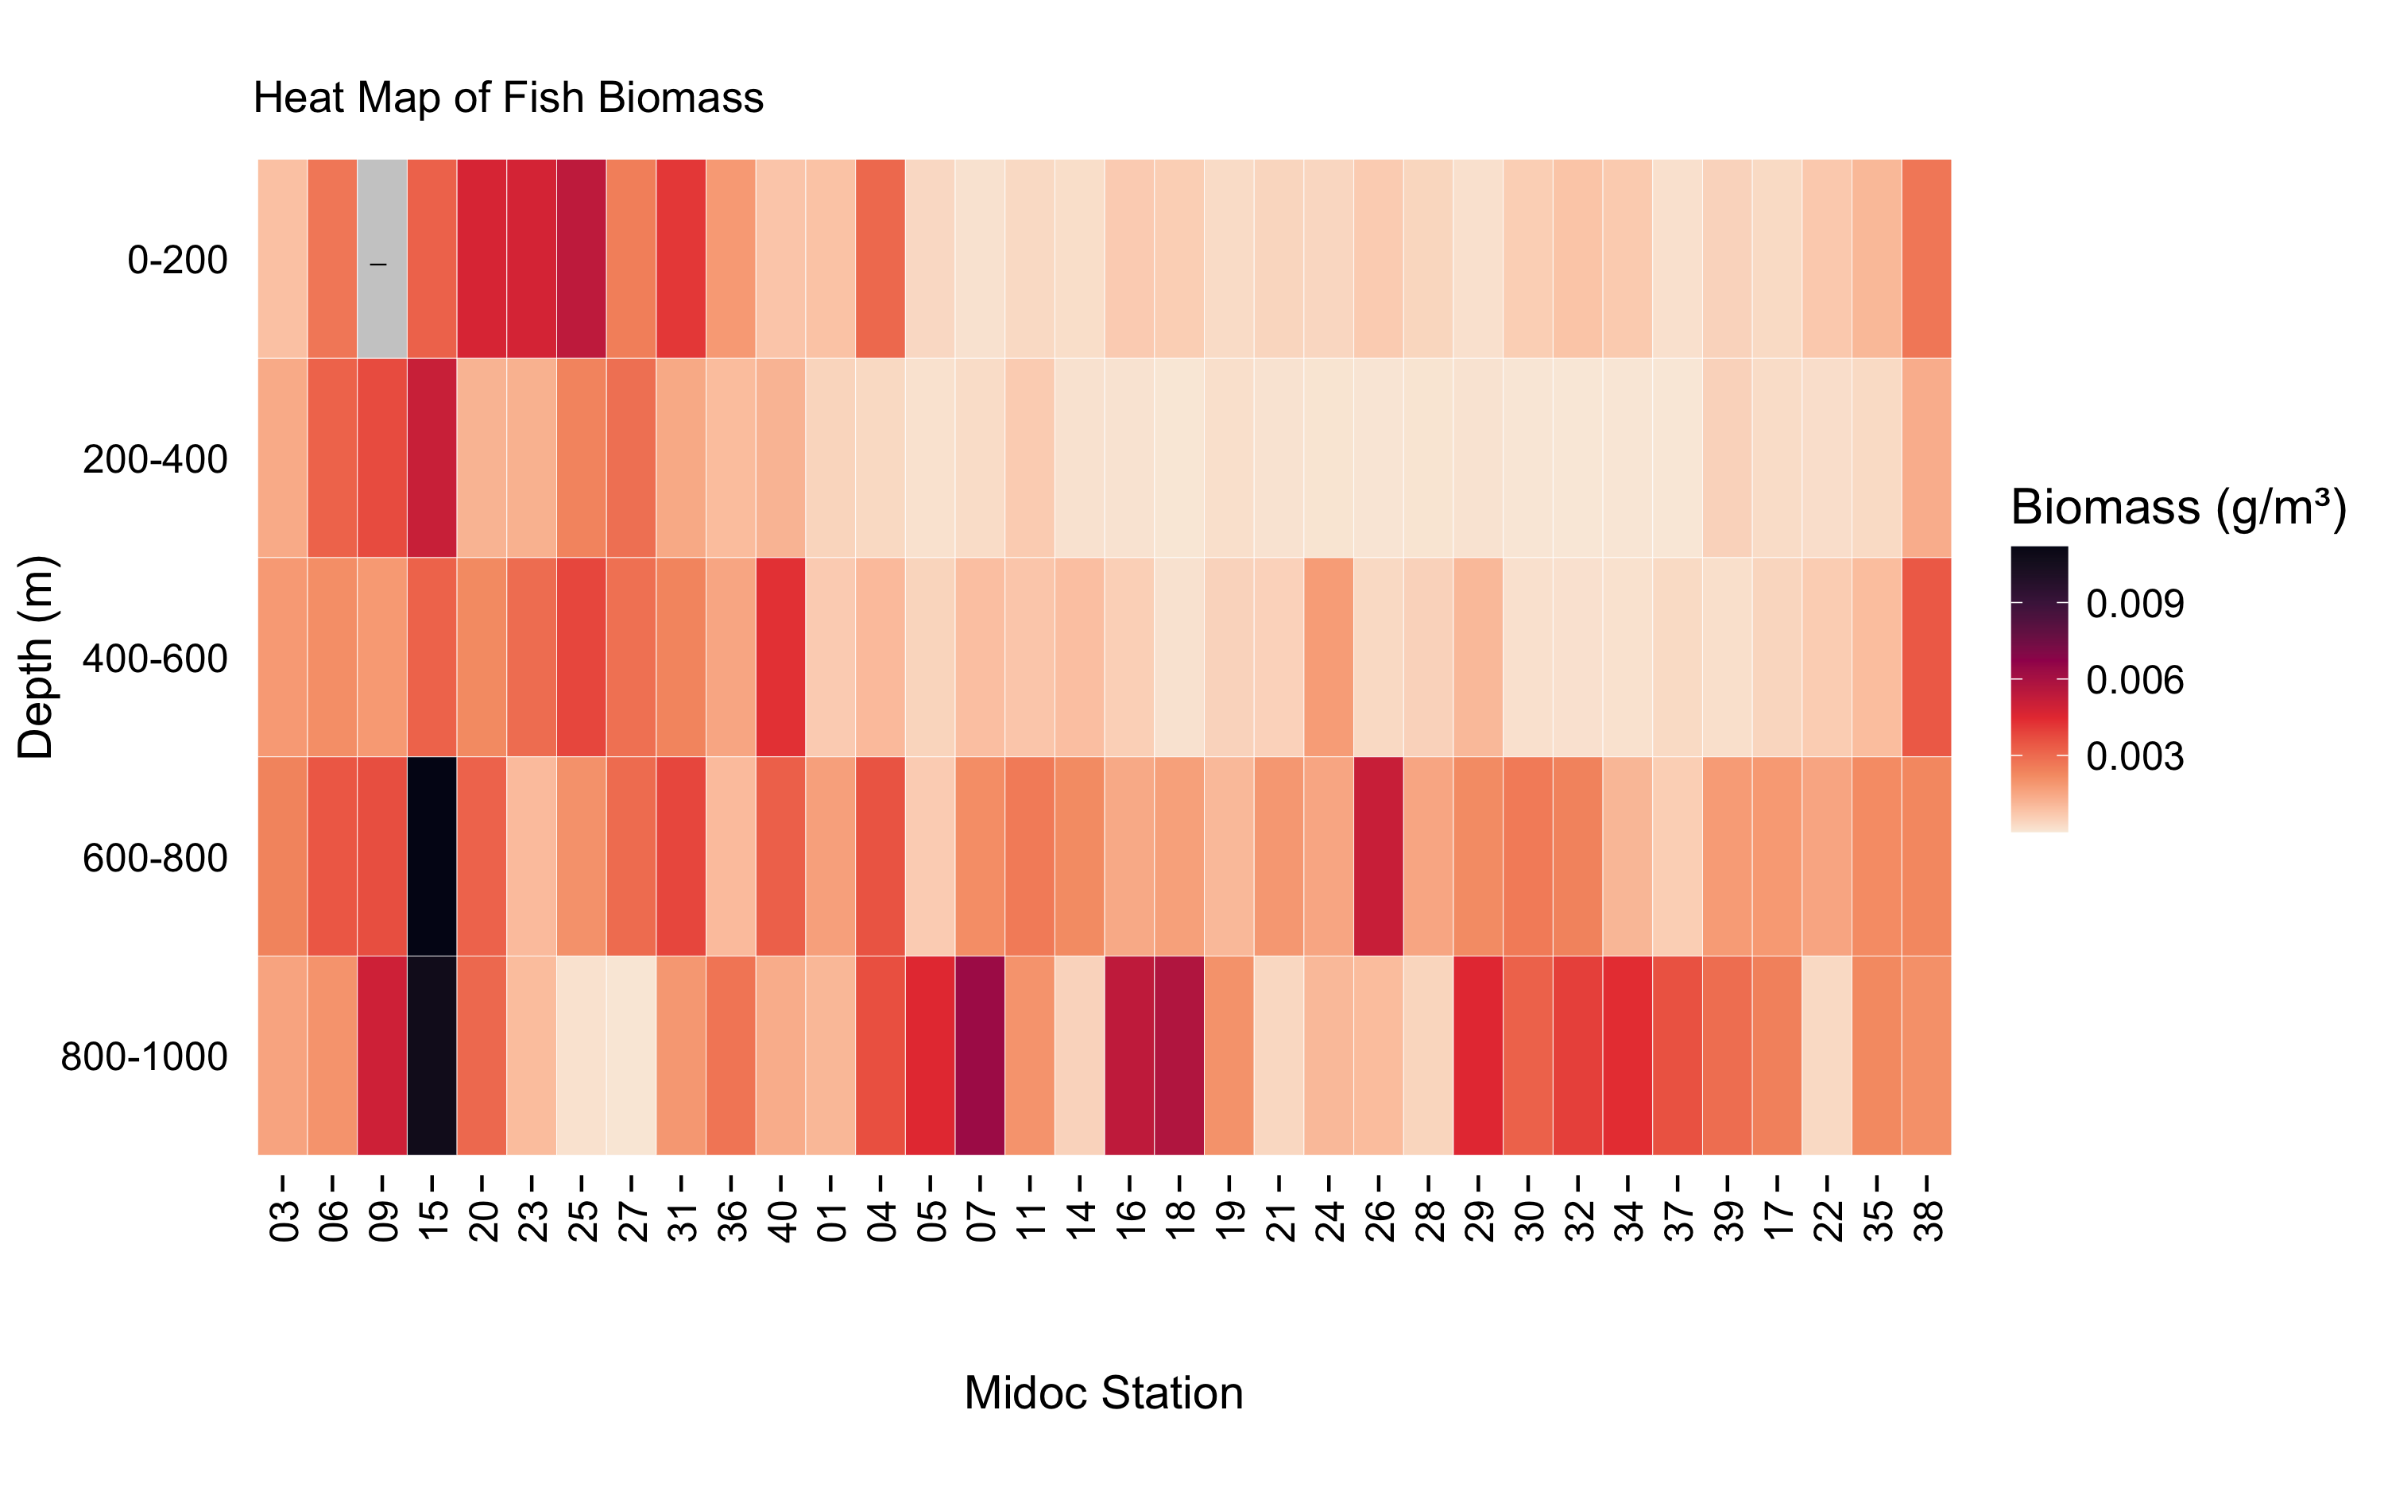

Slide 4
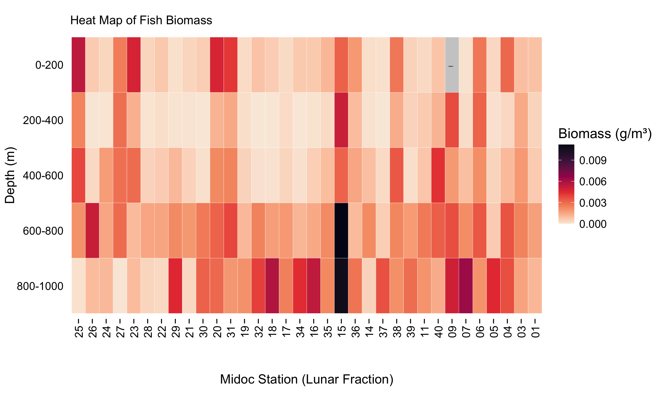






Slide 6
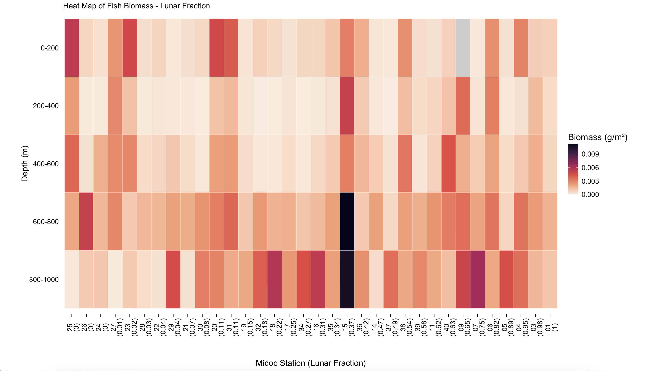

Slide 7
These values were categorized into lunar phases using even sampling intervals centred on the fractional part that defines each lunar phase. Therefore, values 0.875 to 1 and 0 to 0.125 were categorized as ‘new’, 0.125 to 0.375 as ‘waxing’, 0.375 to 0.625 as ‘full’ and 0.625 to 0.875 as ‘waning’.

Slide 12
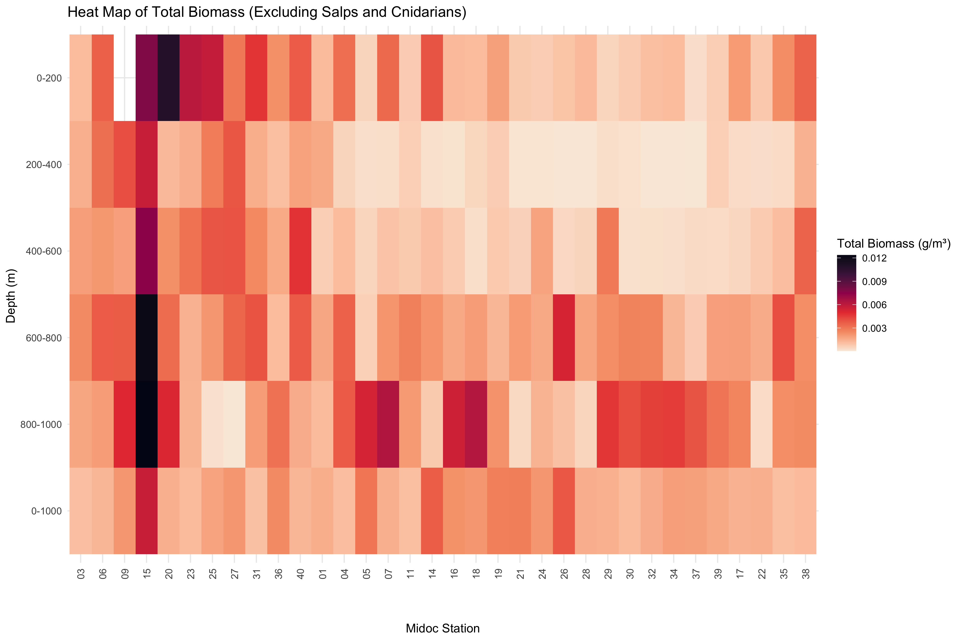


Slide 21
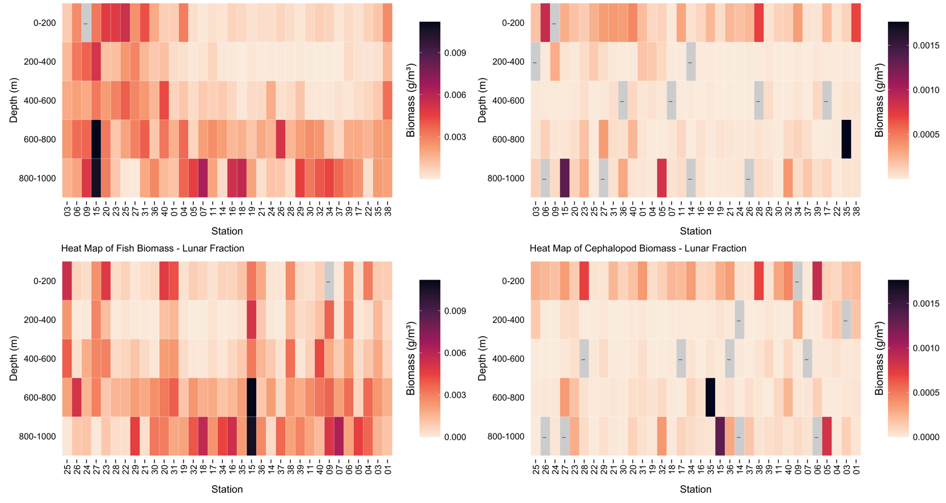


Slide 24
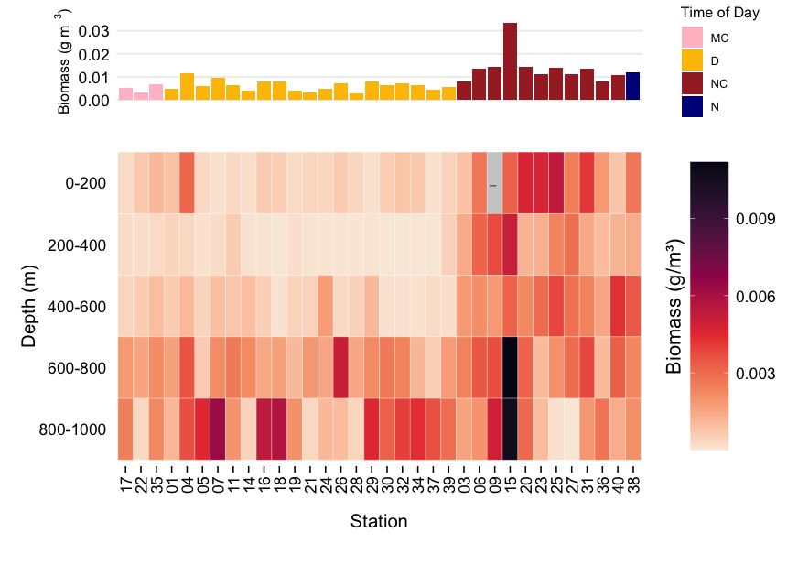

Slide 25
Flip the bottom panels

Slide 28

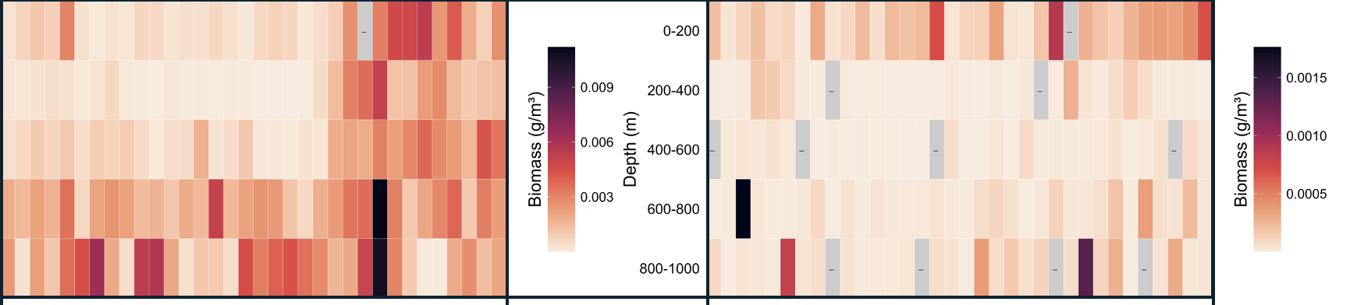

Slide 30
